Slide 1
chapter 7 Moving Beyond Linearity

Slide 2
Standard linear regression can have significant limitations in terms of predictive power. This is because the linearity assumption is almost always an approximation, and sometimes a poor one. In this chapter we relax the linearity assumption while still attempting to maintain as much interpretability as possible. Wedo this by examining very simple extensions of linear models like polynomial regression and step functions, as well as more sophisticated approaches such as splines, local regression, and generalized additive models.

Slide 3
Polynomial regression
Step functions
Regression splines
Smoothing splines
Local regression
Generalized additive models

Slide 4

7.1 Polynomial Regression
Generally speaking, it is unusual to use d greater than 3 or 4 because for large values of d, the polynomial curve can become overly flexible and can take on some very strange shapes. This is especially true near the boundary of the X variable.

Slide 5

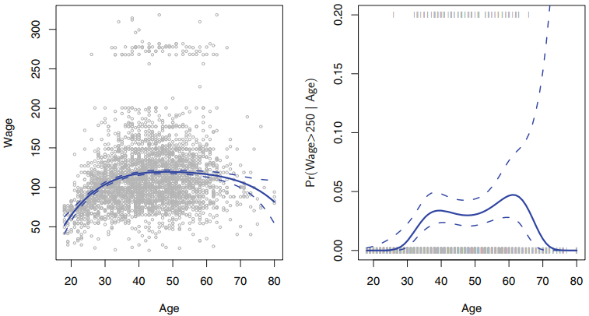


Slide 6
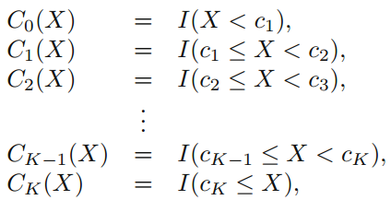
7.2 Step Functions
Here we break the range of X into bins, and fit a different constant in each bin.This amounts to converting a continuous variable into an ordered categorical variable.
We create cutpoints c1, c2, . . . , cK in the range of X, and then construct K + 1 new variables

Slide 7

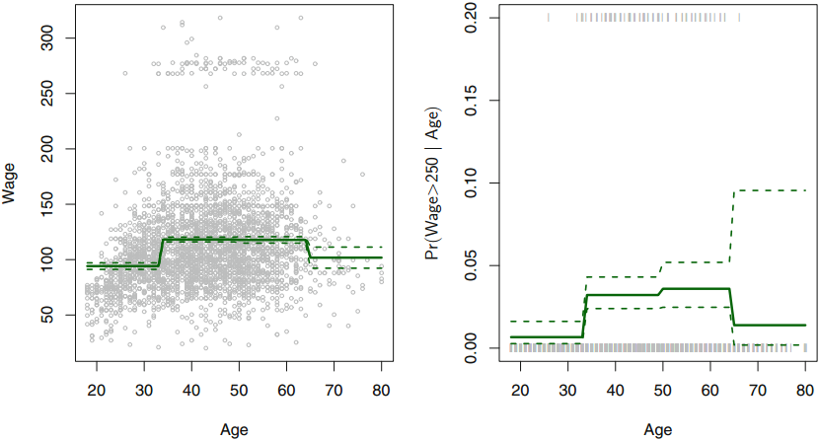

Slide 8


7.3 Basis Functions
Polynomial and piecewise-constant regression models are in fact special cases of a basis function approach. The idea is to have at hand a family of functions or transformations that can be applied to a variable X: b1(X), b2(X), . . . , bK(X).

Slide 9
Thus far we have considered the use of polynomial functions and piecewise constant functions for our basis functions; however, many alternatives are possible. For instance, we can use wavelets or Fourier series to construct basis functions.

Slide 10


7.4 Regression Splines 7.4.1 Piecewise Polynomials
we fit two different polynomial functions to the data, one on the subset of the observations with xi < c, and one on the subset of the observations with xi ≥ c. The first polynomial function has coefficients β01, β11, β21, β31, and the second has coefficients β02, β12, β22, β32.

Slide 11
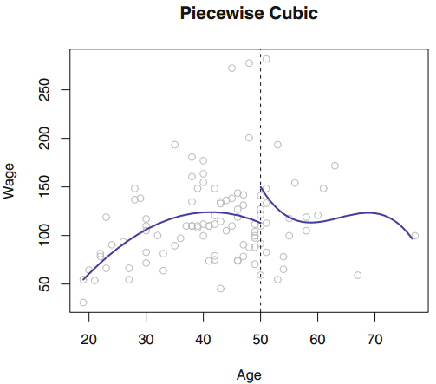

Slide 12
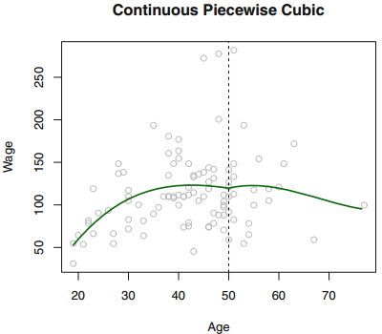
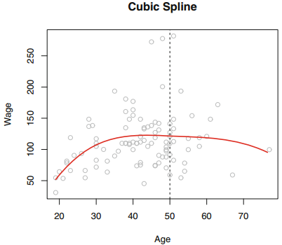
7.4.2 Constraints and Splines
Piecewise Polynomials is just too flexible.
To remedy this problem, we can fit a piecewise polynomial under the constraint that the fitted curve must be continuous.

Slide 13

7.4.3 The Spline Basis Representation
The most direct way to represent a cubic spline is to start off with a basis for a cubic polynomial—namely, x, x², x³—and then add one truncated power basis function per knot.
In order to fit a cubic spline to a data set with K knots, we perform least squares regression with an intercept and 3 + K predictors, of the form X, X², X³, h(X, ξ1), h(X, ξ2), . . . , h(X, ξK), where ξ1, . . . , ξK are the knots.

Slide 14
Unfortunately, splines can have high variance at the outer range of the predictors—that is, when X takes on either a very small or very large value. A natural spline is a regression spline with additional boundary constraints: the function is required to be linear at the boundary (in the region where X is smaller than the smallest knot, or larger than the largest knot). This additional constraint means that natural splines generally produce more stable estimates at the boundaries.

Slide 15
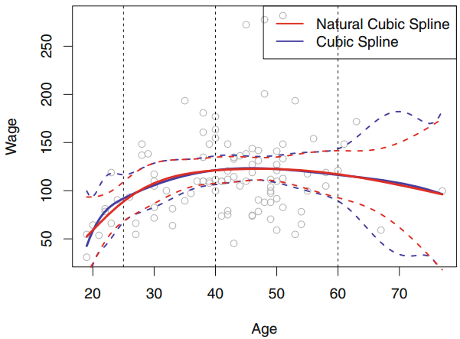

Slide 16
7.4.4 Choosing the Number and Locations of the Knots
When we fit a spline, where should we place the knots? One option is to place more knots in places where we feel the function might vary most rapidly, and to place fewer knots where it seems more stable.
How many knots should we use, or equivalently how many degrees of freedom should our spline contain? One option is to try out different numbers of knots and see which produces the best looking curve. A somewhat more objective approach is to use cross-validation, as discussed in Chapters 5 and 6.

Slide 17
7.4.5 Comparison to Polynomial Regression
Regression splines often give superior results to polynomial regression.
This is because unlike polynomials, which must use a high degree to produce flexible fits, splines introduce flexibility by increasing the number of knots but keeping the degree fixed.
Splines also allow us to place more knots, and hence flexibility, over regions where the function f seems to be changing rapidly, and fewer knots where f appears more stable.

Slide 18
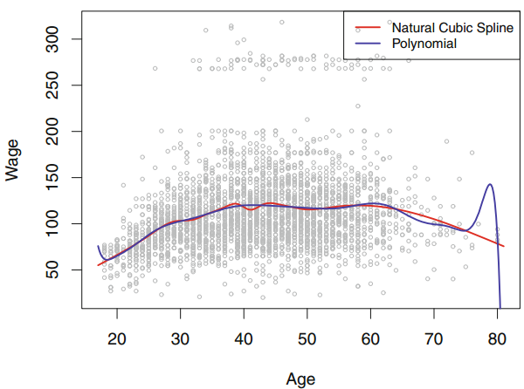

Slide 19


7.5 Smoothing Splines 7.5.1 An Overview of Smoothing Spline
We now introduce a somewhat different approach that also produces a spline.
The equation takes the “Loss+Penalty” formulation that we encounter in the context of ridge regression and the lasso in Chapter 6.

Slide 20
the function g(x) that minimizes (7.11) is a natural cubic spline with knots at x1, . . . , xn!
However, it is not the same natural cubic spline that one would get if one applied the basis function approach described in Section 7.4.3 with knots at x1, . . . , xn—rather, it is a shrunken version of such a natural cubic spline, where the value of the tuning parameter λ in (7.11) controls the level of shrinkage.

Slide 21



7.5.2 Choosing the Smoothing Parameter
We have seen that a smoothing spline is simply a natural cubic spline with knots at every unique value of xi. It might seem that a smoothing spline will have far too many degrees of freedom, since a knot at each data point allows a great deal of flexibility. But the tuning parameter λ controls the roughness of the smoothing spline, and hence the effective degrees off reedom.

Slide 22
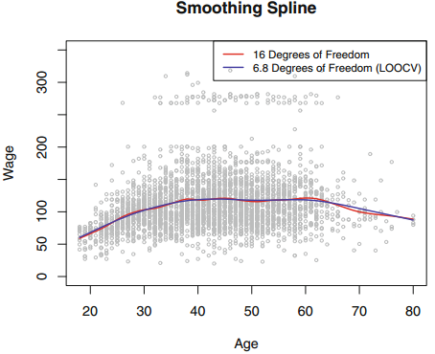

Slide 23
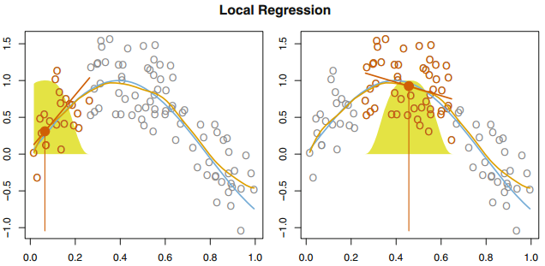
7.6 Local Regression
Local regression is a different approach for fitting flexible non-linear functions, which involves computing the fit at a target point x0 using only the nearby training observations.

Slide 24
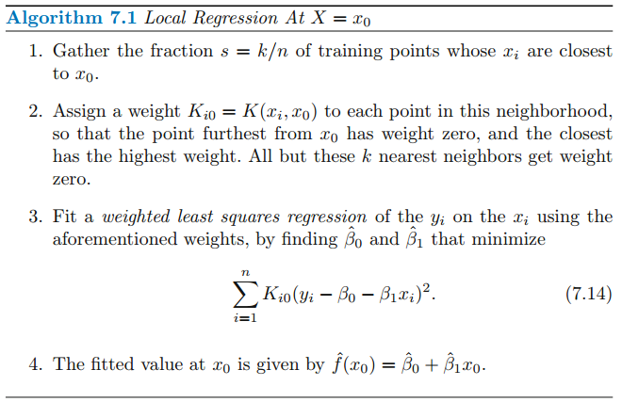

Slide 25
7.7 Generalized Additive Models
Generalized additive models (GAMs) provide a general framework for extending a standard linear model by allowing non-linear functions of each of the variables, while maintaining additivity.

Slide 26


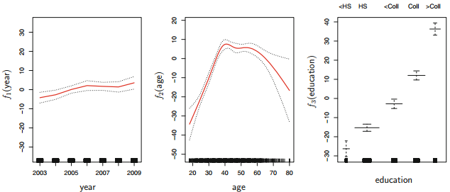
7.7.1 GAMs for Regression Problems

Slide 27
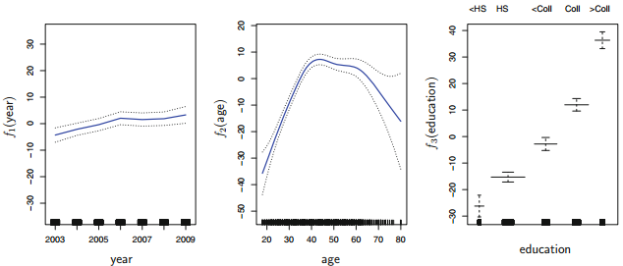
Fitting a GAM with a smoothing spline is not quite as simple as fitting a GAM with a natural spline, since in the case of smoothing splines, least squares cannot be used. However, standard software such as the gam() function in R can be used to fit GAMs using smoothing splines, via an approach known as backfitting.

Slide 28


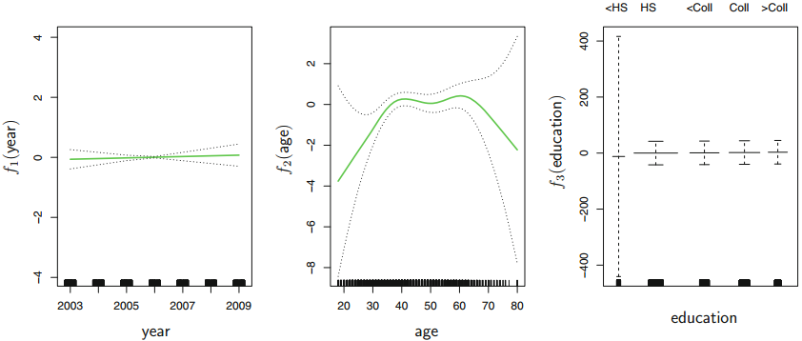
7.7.2 GAMs for Classification Problems

Slide 29
Code: Polynomial Regression and Step Functions
library (ISLR )
attach (Wage)
fit = lm(wage~poly(age ,4, raw =T),data= Wage)
coef( summary (fit))
fit =lm( wage~age +I(age ^2) +I(age ^3) +I(age ^4) ,data= Wage)
coef( fit )
table (cut (age ,4) )
fit =lm(wage~cut (age ,4) ,data =Wage)
coef( summary (fit ))

Slide 30
Code : Cubic Splines
library (ISLR )
library ( splines )
agelims = range (age )
age.grid=seq (from= agelims [1], to= agelims [2])
fit =lm(wage~bs(age ,knots =c(25 ,40 ,60) ),data=Wage )
pred= predict (fit , newdata =list(age =age.grid),se=T)
plot(age ,wage ,col =" gray ")
lines (age.grid , pred$fit ,lwd =2)
lines (age.grid , pred$fit +2* pred$se ,lty ="dashed")
lines (age.grid , pred$fit -2* pred$se ,lty ="dashed")

Slide 31
Code : natural Cubic Splines
library (ISLR )
library ( splines )
agelims = range (age )
age.grid=seq (from= agelims [1], to= agelims [2])
fit=lm(wage~ns(age ,df =4) ,data =Wage)
pred = predict (fit , newdata = list(age = age.grid ),se=T)
plot(age ,wage ,col =" gray ")
lines (age.grid , pred$fit ,col =" red ", lwd =2)

Slide 32
Code : Smoothing Splines
library (ISLR )
library ( splines )
plot(age ,wage ,xlim =agelims ,cex =.5, col =" darkgrey ")
title ("Smoothing Spline")
fit = smooth.spline (age ,wage ,df =16)
fit2= smooth.spline (age ,wage ,cv=TRUE)
fit2$df
lines (fit ,col =" red ",lwd =2)
lines (fit2 ,col =" blue", lwd =2)
legend ("topright", legend =c("16 DF" ,"6.8 DF") , col =c("red","blue") ,lty =1, lwd =2, cex =.8)

Slide 33
Code : Local regression
library (ISLR )
library ( splines )
agelims = range (age )
age.grid=seq (from= agelims [1], to= agelims [2])
plot(age ,wage ,xlim =agelims ,cex =.5, col =" darkgrey ")
title (" Local Regression ")
fit = loess (wage~age ,span =.2, data= Wage)
fit2= loess (wage~age ,span =.5, data= Wage)
lines (age.grid , predict (fit , data.frame (age = age.grid )), col =" red ",lwd =2)
lines (age.grid , predict (fit2 ,data.frame (age = age.grid)), col =" blue",lwd =2)
legend ("topright", legend =c(" Span =0.2" ," Span =0.5") , col =c(" red "," blue ") ,lty =1, lwd =2, cex =.8)

Slide 34
Code : GAMs
library (ISLR )
library ( splines )
library (gam )
gam.m3=gam (wage~s(year ,4) +s(age ,5) + education ,data= Wage)
par ( mfrow =c(1 ,3) )
plot(gam.m3 , se=TRUE ,col =" blue ")

